Slide 1
Sign-Language Recognition Using Machine Learning With Accuracy Analysis
G kiran kumar (318126510139)
M Sumanth (318126510155)
E V M Prateek (318126510138)
Azharuddin (318126510174)
Charan Reddy (317126510106)
Guided By
Dr. V Usha Bala
REVIEW 1

Slide 2

A Quick Recap…
There is a problem when mute people try to communicate with people who do not know sign language. We suggest a solution to this problem using ML based translator that can identify Indian sign language and translate to English.
Existing system and proposed system
Problem segmentation
Data overview and Algorithms

Slide 3
Workflow
Phase 1
Alphabet recognition
Implementing object detection for accuracy analysis, Algorithm selection (image dataset)
Phase 2
Gesture recognition
Including facial gestures and training using video data (10 words)
Training complete model (100 words)Implementing Natural language processing algorithm for sentence generation
Phase 3
Sign recognition

Slide 4
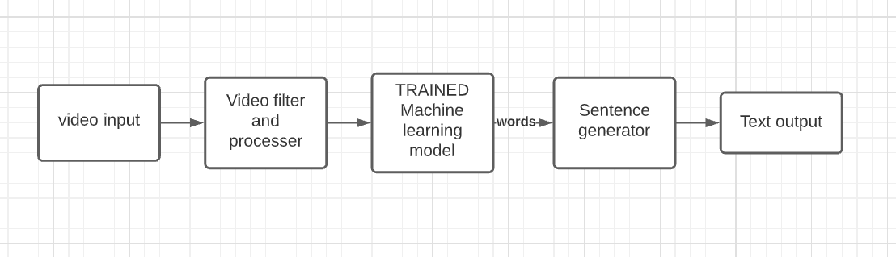

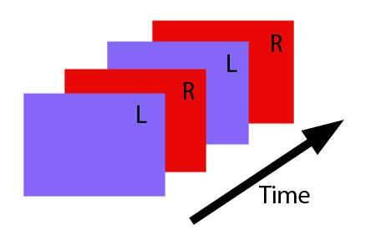
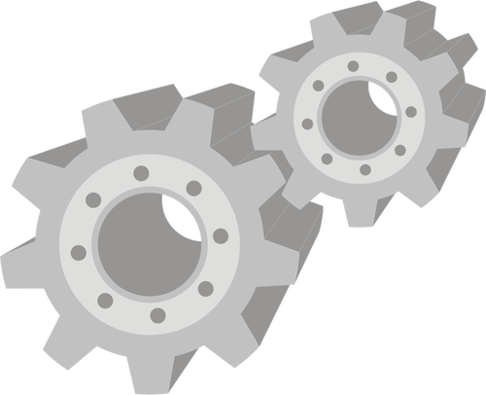
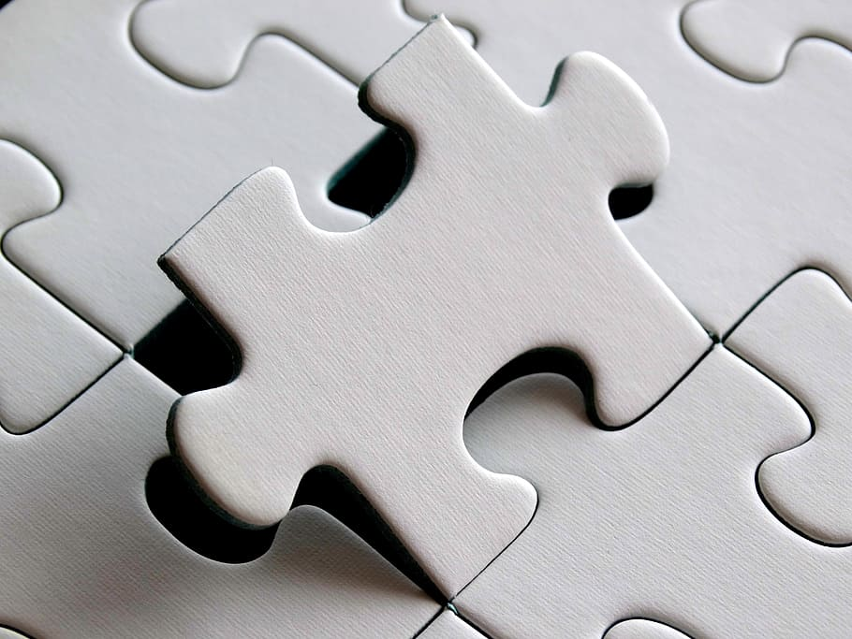
System Architecture
I am Kiran

Slide 5
System Architecture
I am Kiran

Slide 6
Module division
Face gesture
Recognition Model
VIDEO PROCESSOR
Extracts face, hand
Text output
Gui and Speaker output
INPUT
Video or
Image
I am Kiran
Hand gesture recognition Model

Slide 7
Convolution Neural Networks
Training with image data and Extracting Features
Each sign having a certain interval and Automatically detected from input video stream
OUTPUT
Recognised Gesture
Input
Trained model
Image data
Trained using image Dataset
Alphabet based on training data

Slide 8
Code analysis
Training phase
Recognition phase
Input type
Image
Video

Slide 9
Code Analysis
Training phase
Train the CNN algorithm using Images of signs in Indian Sign language
TRAINED MODEL
IMAGES
CNN MODEL

Slide 10
Recognition Phase
Use the trained model to recognise gesture in the video
Recognise the gesture from the video frame
TRAINED CNN MODEL
RECOGNISED GESTURES
LIVE VIDEO

Slide 11
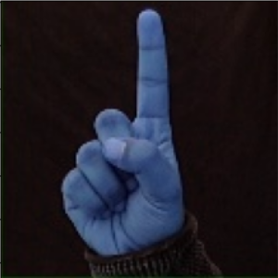
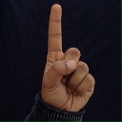
Dataset Acquisition and Modifications
Dataset is taken from Kaggle (Link)
Transformed dataset to account both right hand and left hand users.

Slide 12

Technologies used
Tensorflow
To train the CNN model using the inbuilt Modules in tensorflow
Tkinter
To make a stand-alone applications with various elements available in Tkinter
Pickle
To convert Images to Matrices and saving them for training and testing on future

Slide 13
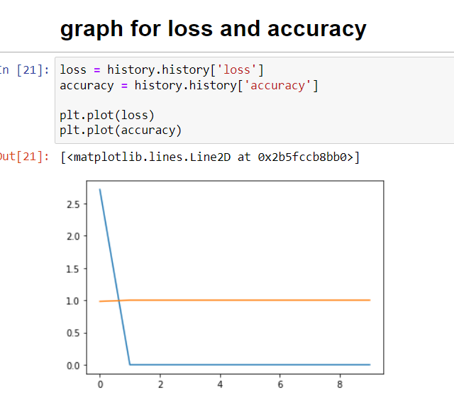
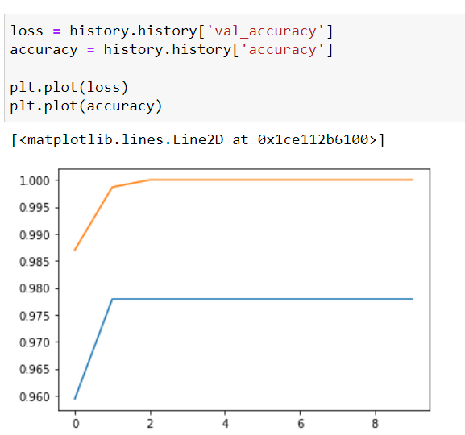
Accuracy Graphs

Slide 14
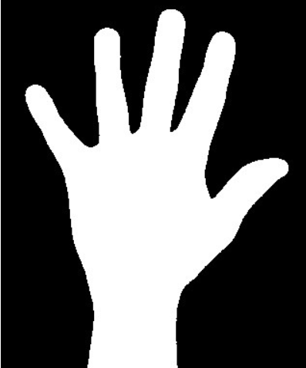
Existing problem and our solutions to the problem
Existing problem
We’ve found that the hands with black background are accurately recognised, where as hands with colored background are not being recognised.
Suggested solution
The Solution we came up with is to find outline of the hand and to differentiate the hand in the image from the background.

Slide 15
Constraints
Other objects apart from the signs are not recognised
For Noisy images output is not accurate

Slide 16
Moving Forward
Going to implement the potential solutions and see if the accuracy improves.
The Video Dataset is chosen in the further phase when accuracy result is satisfactory.
Using 13 Classifications of video dataset which include various gestures.
Frames from the video is extracted and are recognised by the trained model that follows similar recognition to the phase 1.

Slide 17
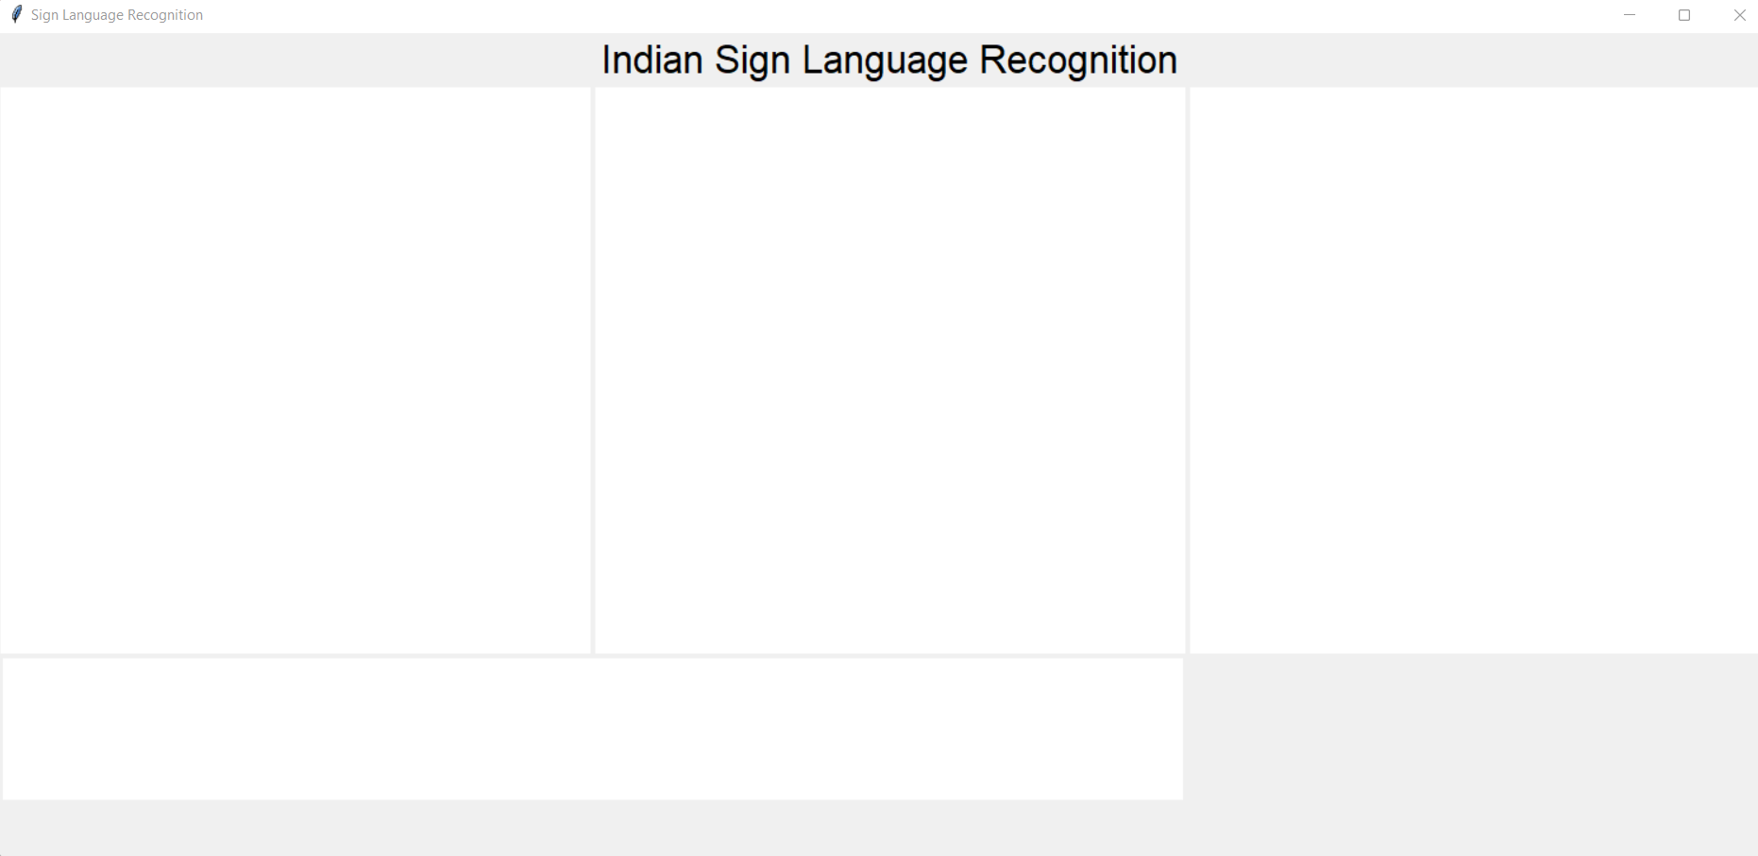
Sample Output
Video input
Processed
video
HI

Slide 18
References
Implementation references
Tensorflow Reference videos
Tkinter for GUI videos
Pickle videos
Tensorflow Documentation
Tkinter Documentation
Pickle Documentation

Slide 19
References
Research Papers
Accuracy analysis paper
Project Idea paper
Implementation inspiration paper
https://drive.google.com/file/d/1gOO20k-eyH7GtNm1PfjSQ5wXD9w6_5kD/view?usp=sharing
https://drive.google.com/file/d/1EIQ-XWRxuzSEGoclHD1yBYRLzSeUpB18/view?usp=sharing
https://drive.google.com/file/d/14sdlBv7UYz2qbprNgnMNL1QyvZBZFyXU/view?usp=sharing

Slide 20
References
Documentation , words selected
project details
Project documentation
Official Sign translation and dictionary
https://indiansignlanguage.org/
http://www.islrtc.nic.in/

Slide 21
Thank you for your time.

